Slide 1
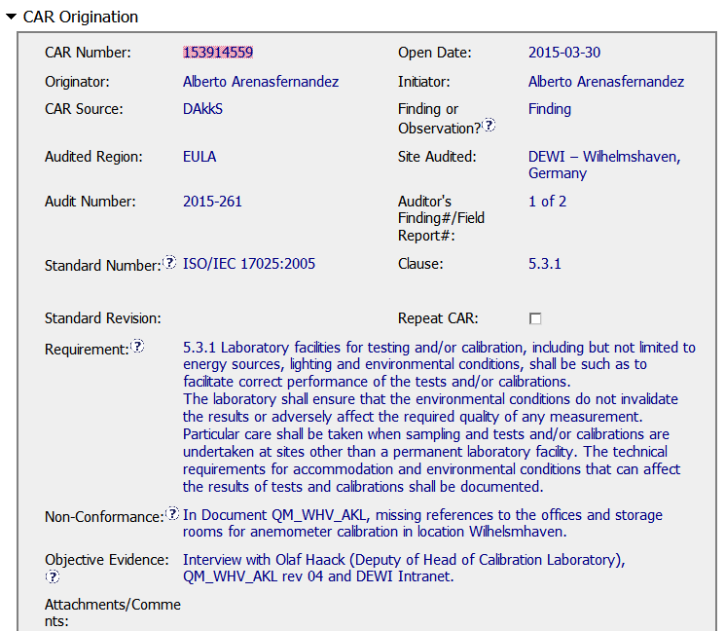
CAR# 153914559 – Finding, Origination
Audit and Finding #s correlate with audit calendar and report
5.3.1 requires that the facility (where ever it is) meets with the accommodation and environment requirements.
While the requirement has been spelt out clearly, I’m having a hard time understanding why was this a NCR in the first place.

Slide 2
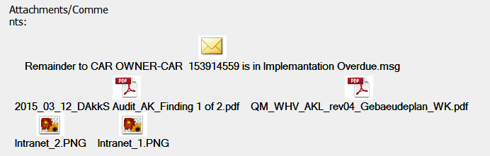
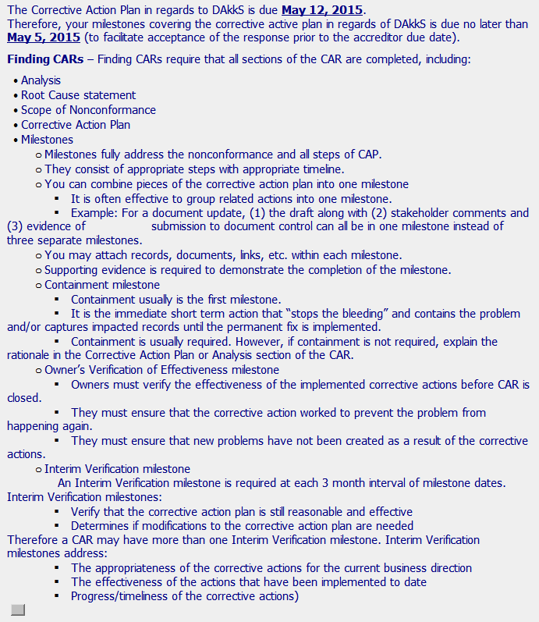
CAR# 153914559 – Finding Attachments/Comments
Documents not in English
While this is good to have, there needs to be a balance, as too much instruction is often overwhelming. Instead links should be the preferred option.

Slide 3
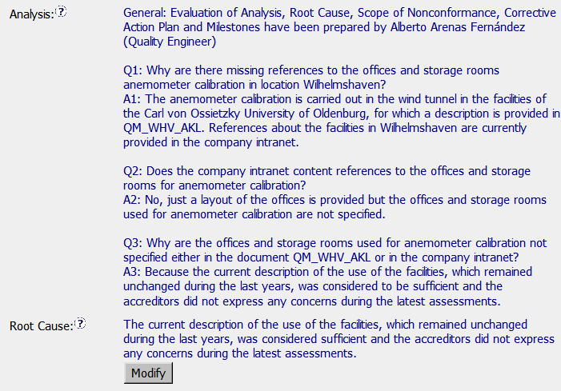
CAR# 153914559 – Finding Analysis, RCA, CPA …
Other Stakeholder input is not evidenced
The analysis addresses the NCR as stated.
Was the Accreditor (auditor) the same person? This does not appear to be adequate. Input from additional stakeholders would have benefited.
The root cause could have been “lack of peer review of the layout prior to posting on the Intranet”.

Slide 4
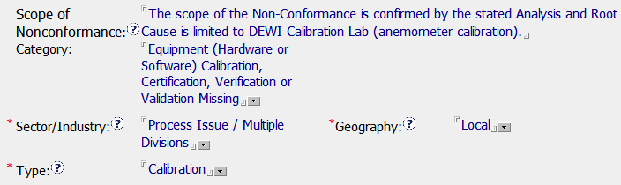
CAR# 153914559 – Finding, NCR Scope, Category & Type
This is not a Calibration issue. Instead pertains to Accommodation and Environmental conditions as per section 5.3 of ISO/IEC 17025.
The Type should have been Document Control or Record Handling in the absence of one for Facilities.

Slide 5
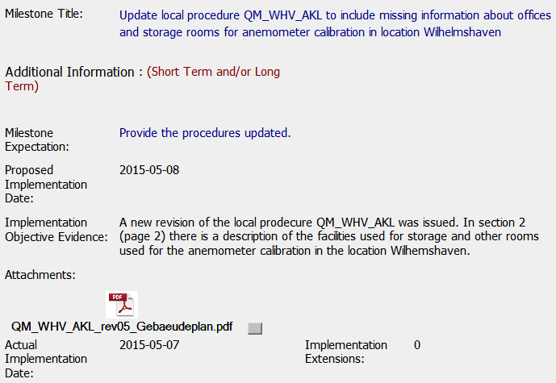
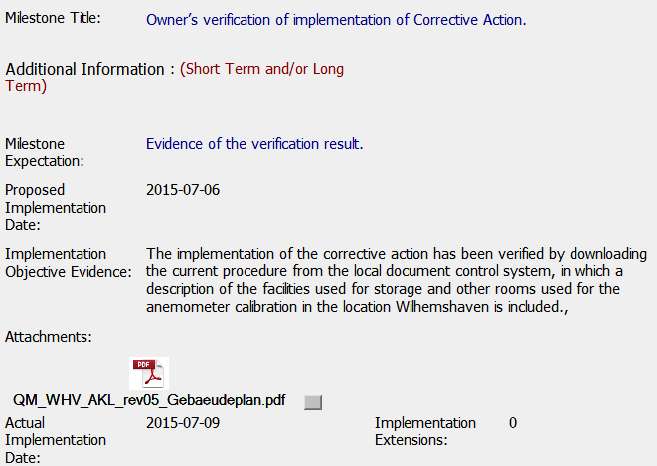
CAR# 153914559 – Finding, Milestones …
Document not in English, however, based on the objective evidence it appears the issue has been addressed.
If this is a copy downloaded from DCS, the expectation would have been to see the names of the staff who prepared, reviewed and approved the document. This is not evidenced. Neither does the document have a date!

Slide 6
CAR 153914559 – CBS Check
CBS Requirements | Excellent | Moderate | Need Improve | N/A
INTEGRITY
(C) Extensions are within requirement (<30 days, 3 or less) |  |  |  | x
(T) Most appropriate ‘category’, ‘type’, ‘geography’ are selected |  |  | x
(P) Facilitates the handling of disputed CARs |  |  |  | x
(T) Acts on CARs within required timeframe | x
COMPETITIVENESS
(C) Analysis shows clear path to root cause and scope; stakeholders identified |  | x
(C) Root cause statement is succinct, reasonable, complete (Shows ‘N/A’ for observations) |  | x
(C) Corrective actions fix the objective evidence and other problems found; address entire root cause and scope. For observations, they do not go beyond fixing the objective evidence |  | x
(C) Milestones address containment & owner’s verification; completed per milestone expectations |  | x
(P) Verification per requirements |  |  | x
COLLABORATION
(L Referenced communications are attached as needed | x
(C L) Evidence of communication for overdue/escalated CARs and other pertinent concerns |  |  |  | x
(P) Trains other CAR Champions |  |  |  | x

Slide 7
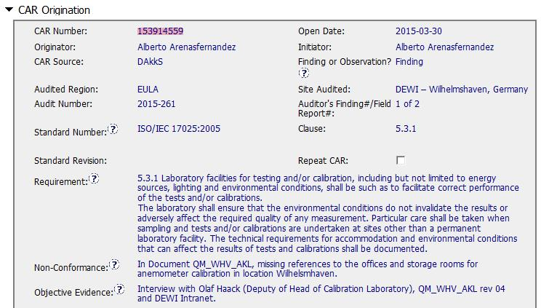
CAR 153914559
Background:
Not found office and storage rooms location in SOP, then the compliance of
Clause 5.3.1 (Environment Condition do not invalidate the results) was in question.

Slide 8
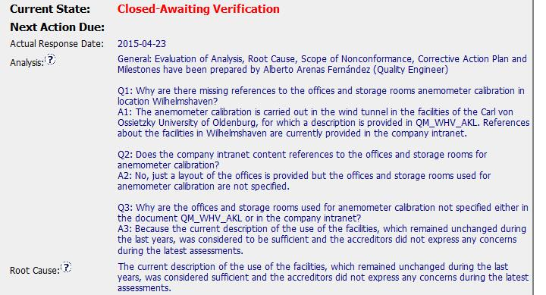
CAR 153914559
Excellent -
1. Stakeholder involved.
2. Clear and Step by Step to make analysis.
Improvement -
1. Would be better if explain no impact on the test results without reference to office and storage rooms
Improvement –
1. Wonder it (Accreditor did not express any concerns during the latest assessment) would be one of root cause

Slide 9
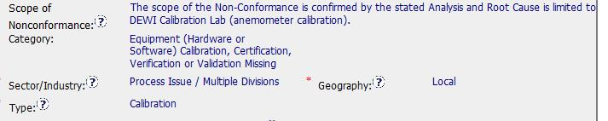
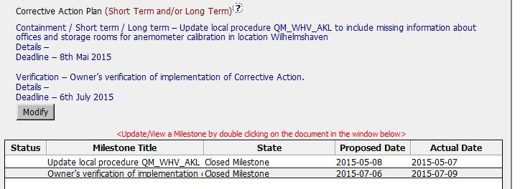
CAR 153914559
The selection Scope of Category, Type and Geography are suitable
Excellent (Integrity-T)-
Appropriate Containment, corrective action plan, milestone.
and verification are setup
The verification milestone needs to detail exactly what is expected from
the CAR owner and not a general statement saying provide verification results.

Slide 10
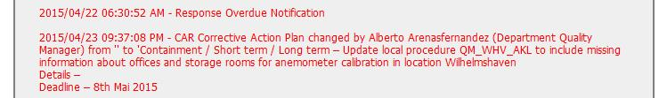

CAR 153914559
Improvement –
Overdue Notification was happen twice. It would be better if CAR Champion would alert and discuss the CAR owner to extend the Milestone due date

Slide 11

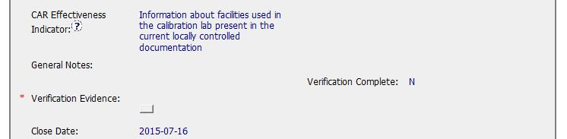
CAR 153914559
Improvement – CAR was closed at July, but still waiting verification (Over around two months). It would be better if CAR Campion verify it as effective within appropriate time period.

Slide 12
CAR 153914559 – CBS Check
CBS Requirements | Excellent | Moderate | Need Improve | N/A
(C) Extensions are within requirement (<30 days, 3 or less) |  |  | √
(T) Most appropriate ‘category’, ‘type’, ‘geography’ are selected | √
(P) Facilitates the handling of disputed CARs |  |  |  | √
(T) Acts on CARs within required timeframe |  |  | √
(C) Analysis shows clear path to root cause and scope; stakeholders identified | √
(C) Root cause statement is succinct, reasonable, complete (Shows ‘N/A’ for observations) |  | √
(C) Corrective actions fix the objective evidence and other problems found; address entire root cause and scope. For observations, they do not go beyond fixing the objective evidence | √
(C) Milestones address containment & owner’s verification; completed per milestone expectations | √
(P) Verification per requirements |  |  | √
(L) Referenced communications are attached as needed |  |  |  | √
(C L) Evidence of communication for overdue/escalated CARs and other pertinent concerns |  |  | √
(P) Trains other CAR Champions |  |  |  | √

